Slide 1
Lyric Classifier
Joshua Larson

Slide 2
Executive summary
I wanted to create a simple classifier that could determine the genre of a song based on the lyrics. Generally, classifiers of this type are of limited accuracy, around 60-80%. The classifier does a good enough job of classifying songs as pop, rock, or rap but accuracy for more specific genres was more limited. I found it interesting that lyrical classifiers were not more accurate, this suggests that songs are more complex than their lyrical make up and a more accurate classifier would likely need use lyrics and sound files. I expected lyrical classification to be accurate the vast majority of the time.

Slide 3
Problem statement
The project was meant to explore the ability of machine learning algorithms to classify songs based on their lyrics. If you want to classify a large library of songs, perhaps every song that has been published, you would need an efficient classifier. The classifier would be used to classify songs for this library. The most difficult problem is the number of crossover artists and songs whose lyrics cannot be simply placed into one genre or another.

Slide 4
Model
There are a number of models used for this.
This case used the Naïve Bayes model
Scikit definition: “Naive Bayes methods are a set of supervised learning algorithms based on applying Bayes’ theorem with the “naive” assumption of conditional independence between every pair of features given the value of the class variable.”(scikit-learn.org, 12/15/2021)

Slide 5
Results
The program I created is not able to reliably or accurately classify songs according to their lyrics.
Song classification is complex, partially because of the number of crossover artists and songs
The classifier miss classified the classic country song Big Iron by Marty Robbins, but was able to accurately classify “Gone Away” by the Offspring.

Slide 6
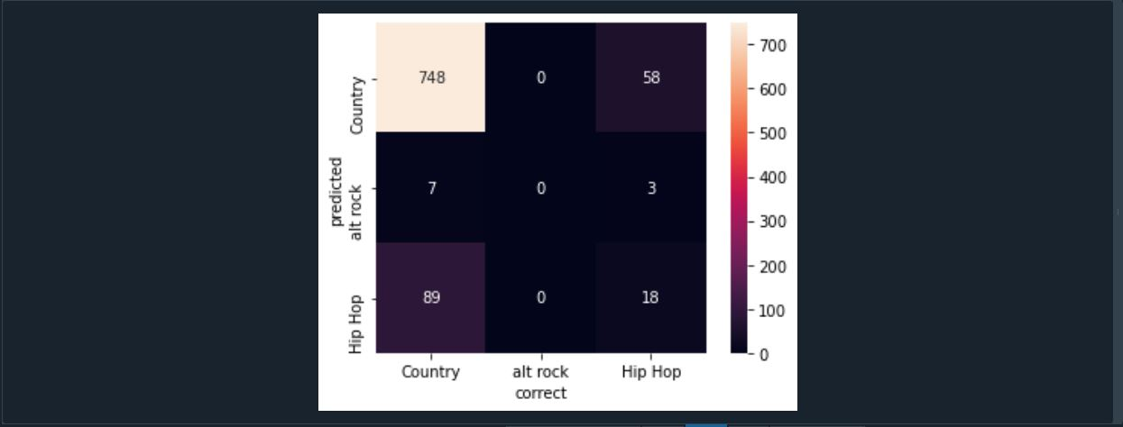
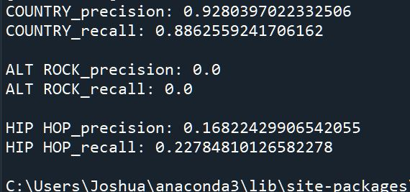
Results

Slide 7
Works Cited
“1.9. Naive Bayes.” Scikit, https://scikit-learn.org/stable/modules/naive_bayes.html. Ciutacu, Lorena. “Building a Lyrics Scraper and Classifier in Python.” Lorena Ciutacu, 23 Oct. 2020, https://lorenaciutacu.com/2020-10-24-bootcamp4/. Dobbins, Tim. “Using Naive Bayes to Predict
a Song's Genre given Its Lyrics.” Grid-Searched, 15 Feb. 2018, https://tmthyjames.github.io/2018/february/Predicting-Musical-Genres/.
Isenberg, Sam. “Lyrics-Classifier/lyrics_classifier.Ipynb at Master · Saisenberg/Lyrics-Classifier.” GitHub, https://github.com/saisenberg/lyrics-classifier/blob/master/python/lyrics_classifier.ipynb.
“Sklearn.pipeline.pipeline.” Scikit, https://scikit-learn.org/stable/modules/generated/sklearn.pipeline.Pipeline.html.

